Slide 1

TLA+ & TLA+ toolbox
Group 26:
Jiaxuan Zhang
Yiting Li
2020.1.14
QEES Tool Survey
Notes:
Hello, everyone, This is group 26. We will have a presentation about TLA+ and TLA+ toolbox.

Slide 2
01
Introduction
02
Main Idea
CONTENTS
03
Language
04
TLA+ Toolbox
05
Demos
Notes:
we will first introduce the basic information of the TLA+ and TLA+ toolbox.
Next the core conceptions and important ideas about it.
Then the Grammar and the usage of TLA+ Toolbox.
Finally, there are two demos.

Slide 3
Introduction
Notes:
The first section is a basic introduction.

Slide 4
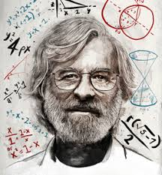

TLA+
A formal specification language developed by Leslie Lamport
Design, model, document and verify: software above the code hardware above the circuit level systems, especially distributed systems
Based on mathematics and does not resemble any programming language
Notes:
We have learned Petri-Net before. Petri net is one of several mathematical modeling languages for the description of distributed systems.
Similarly, TLA+ is a kind of formal specifical language developed by Leslie Lamport, a famous computer scientist.
TLA+ is used to design, document, and verify software, hardware, and real-life systems, especially distributed systems and concurrent systems.
TLA+ is based on mathematics and does not resemble any programming language.

Slide 5
TLA+ Toolbox
The TLA Toolbox is an IDE (integrated development environment) for the TLA+ tools.
Create and edit your specs, with the locations of parsing errors marked in the modules.
View the pretty-printed versions of your modules.
Run the TLC model checker. The Toolbox allows you to explorer an error trace produced by TLC
Run the TLA+ proof system.
Users who would prefer a more lightweight IDE for TLA+ may want to try the Visual Studio Code extension for TLA+.
Notes:
Here comes the TLA+ toolbox. TLA+ toolbox is an IDE help us to parse or generate printed-vision model, and integrated TLC checker.
You can also use VS code extensions of TLA+

Slide 6
Main Idea
Notes:
In the second section, we will introduce core conceptions and important idea about TLA+

Slide 7
State Machine
TLA+ is state-based it models an execution of a system as a sequence of states behavior: a sequence of states step: a pair of consecutive states
TLA+ describes a set of behaviors with two things: An initial condition: specifies the possible starting states. A next-state relation: specifies the possible steps This kind of model is often called a state machine
TLA+ define the set of ordered pairs to model a system by describing the next-state relation
Notes:
First of all, TLA+ is state-based. When describing a system, it models an execution of a system as a sequence of states.
And in many related resources, a sequence of states is called behavior. A pair of consecutive states is defined as a step.
A TLA+ program tries to describe a set of behaviors with two things:
One is initial condition, specified the initial state of a system,
another is next-state relation, specified possible action from a state.
Almost the same as describing a state machine.
From my perspective, when trying to model a system with TLA+, we define the set of ordered pairs by describing the next-state relation。

Slide 8
Property Check
Invariant:
Invariant is a property of a mathematical object (or a class of mathematical objects)
it remains unchanged after operations or transformations of a certain type.
Temporal Formula:
temporal formula describe temporal logic
temporal logic is any system of rules and symbolism for representing, and reasoning about, propositions qualified in terms of time
Attention:
Most times, TLA+ cannot check the property “Theoretically”
It tries to find whether a property is satisfied in a practical-size state space by searching each state
Notes:
After modeling the system, we need to check the property of a system.
In TLA+, we have two kinds of properties: Invariant and Temporal Formula.
An invariant is a property of a mathematical object that remains unchanged after operations or transformation
Temporal Formula describes temporal logic; temporal logic means it’s Boolean value may change in time.
Pay attention, although TLA+ is based on mathematics. Most times, it cannot check the property “theoretically.”

Slide 9
Search Method
TLA+ tries to find whether a property is satisfied in a practical-size state space by searching each state
The searching method is Breadth First Search (BFS) by default
I
Notes:
That means TLA+ tries to find whether a property is satisfied in practical-size state space by searching each state.
By default, the searching method is BFS.
For example, in the state space shown,
it first checks the root
then the adjacent 3 states of level 2
and finally, the outer of level 3.

Slide 10
Grammar

Slide 11


Contents of Grammar
How to build model
An operator refer to a thing that does a thing, such as “==” or “=” or ”\in” etc.
Example:
Other operator:
If-else operator

Slide 12


Contents of Grammar
Sets:
Sets is often used in TLA+, basic operation and serval transformation is introduced to TLA+.
Defining a set:
Another set Defining :
Set operation:

Slide 13




Contents of Grammar
Expression:
An expression is anything that follows an operator like ==, =, :=, or \in.
Constant expression:
Variables expression:
Action expression:
"EXECPT" detailed explanation:
https://www.youtube.com/watch?v=JwO4yPSEp-0&t=1034s

Slide 14


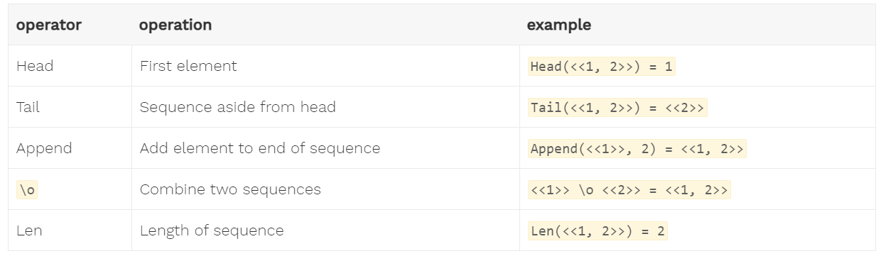
Contents of Grammar
Tuple:
Finite ordered list, specifying them with <<>>
Ordered pair:
Basic tuple operation:

Slide 15



How to build a model
Function:
A function is a binary relation between two sets that associates every element of the first set to exactly one element of the second set.
Defining a function (two ways):
Example:
The state function describes binary relation between r and if-else expression

Slide 16
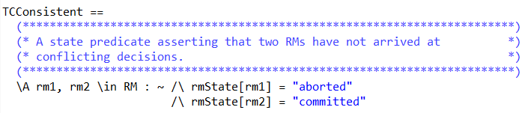
How to describe Property
Using formula to describe propety.
Example:
"aborted" and "committed" can't happen at the same time.
Other operator:
[]P, means that P is true for all states
<>P. means that for every possible behavior, at least one state has P as true
P ~> Q, implies that if P ever becomes true, at some point afterwards Q must be true
<>[]P, says that at some point P becomes true and then stays true

Slide 17
TLA+ Toolbox

Slide 18

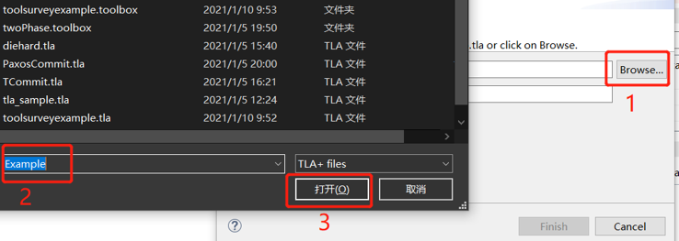
Structure
How to build model
Toolbox link: https://lamport.azurewebsites.net/tla/toolbox.html
Download and install it
Creating a new sepc:
Select a file:

Slide 19
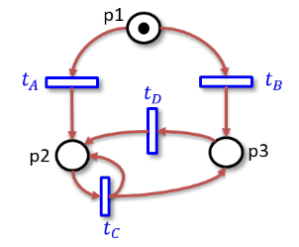
Demo 1
Considering a Petri-Net
Verification 2
Verification 3
Marking m = (0,1,10) can happen infinitely often
Notes:
Here is our Demo;
we will use TLA+ to test whether it satisfies “for any reachable marking, token in p2 is less than or equal to the token in p3.”
and test whether marking m=(0,1,10) can happen infinitely often

Slide 20
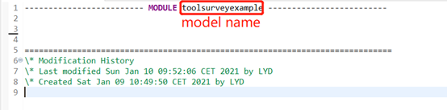

Structure
How to build model
Here to build our model
If model is parsed, a symbol will be shown in the right bottom:
Building model phase is done.

Slide 21
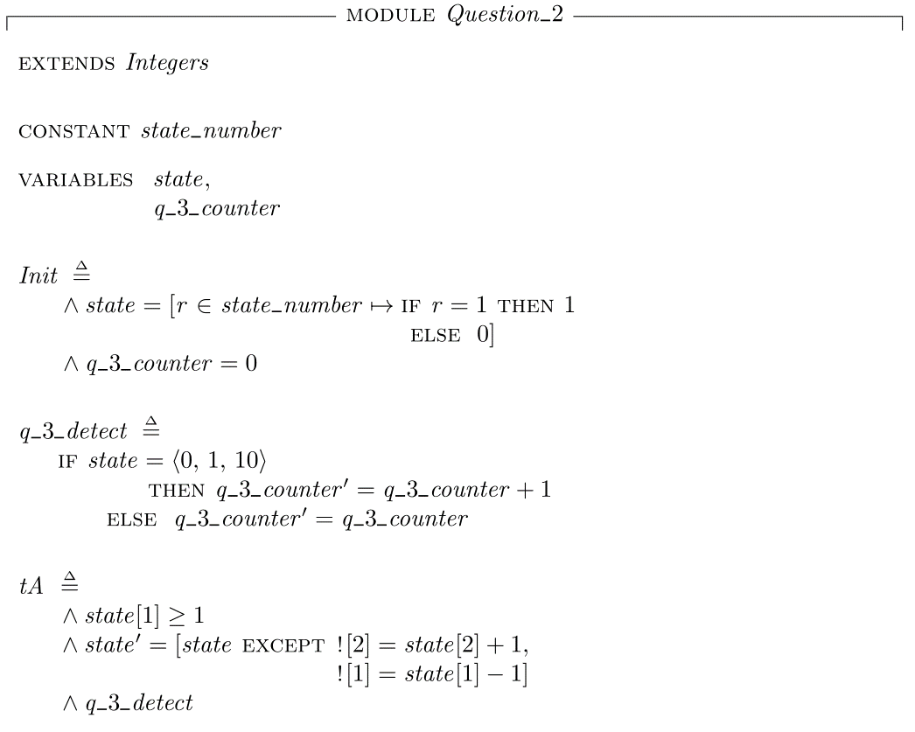
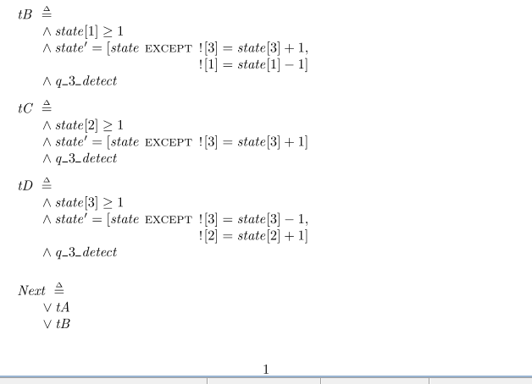
Model
Notes:
First, we model this system with TLA+
the Variable: state defines the places in the Petri net, and constant will be defined as the set of state index
Init defines the initial state, in which except place 0 is 1 other place is empty.
Each operation is defined as below
for example, tB means,
when at the current state, if place 1, has more than 1 token,
then transition tB can be fired,
and in next state, place 3 add one token,
place 1 minus 1 token,
the total possible transition is defined as Next;
the expression means,
in a state, if the condition is met, tA or tB or tC or tD can happen

Slide 22

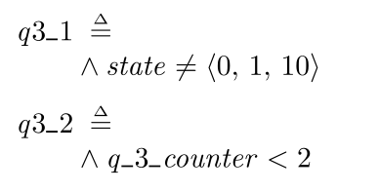
Describe the Property
Question 3
First divide into two steps A: initial state can arrive to the first (0,1,10) ? B: (0,1,10) can arrive at (0,1,10) again ? Initial Proposition = A\/ B
Question 2
Next describe the Property

Slide 23
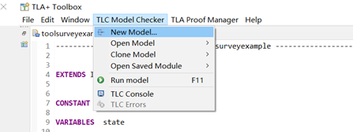
Set the TLC checker
Open a TLC model checker:
Name this model .e.g "model1"

Slide 24
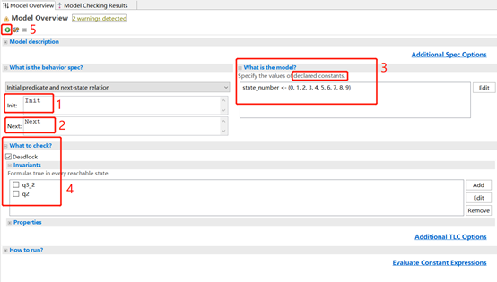
Set the TLC checker
TIC model checker window:
Following step 1-5 to run this model checker

Slide 25
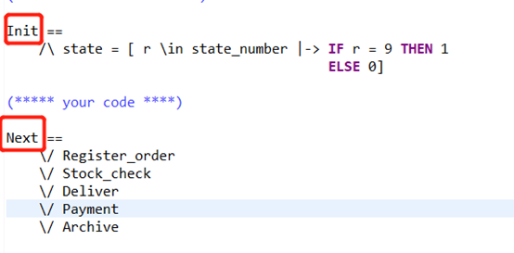
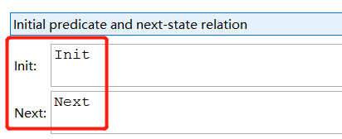
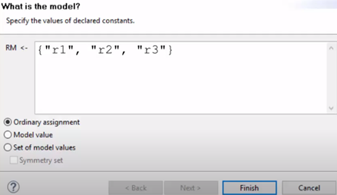
Structure
How to describe property
Step1&2:
Step3: constants specification

Slide 26
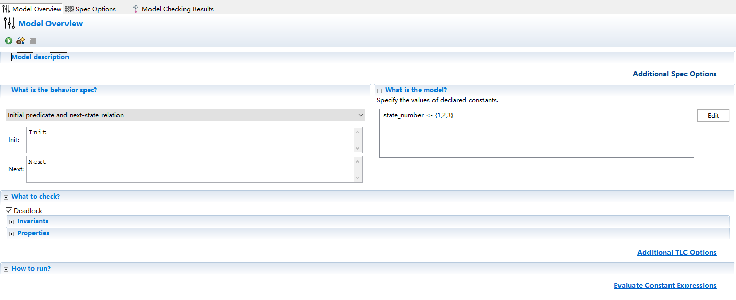
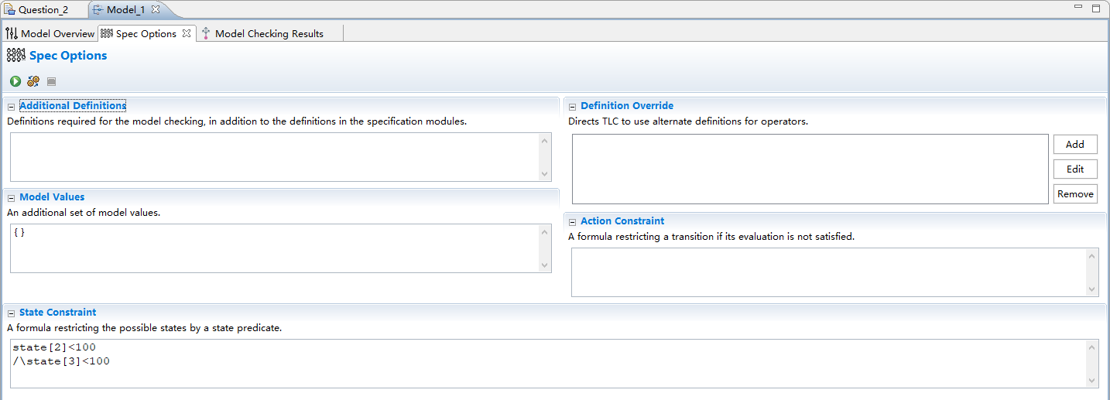
Set an upper-bound
Attention:
Most times, TLA+ cannot test the property “Theoretically”
It tries to find whether a property is satisfied in a practical-size state space
So we set an upper-bound

Slide 27
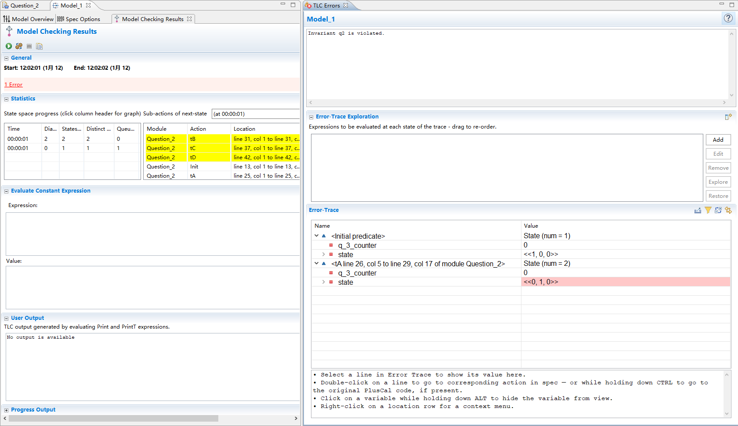
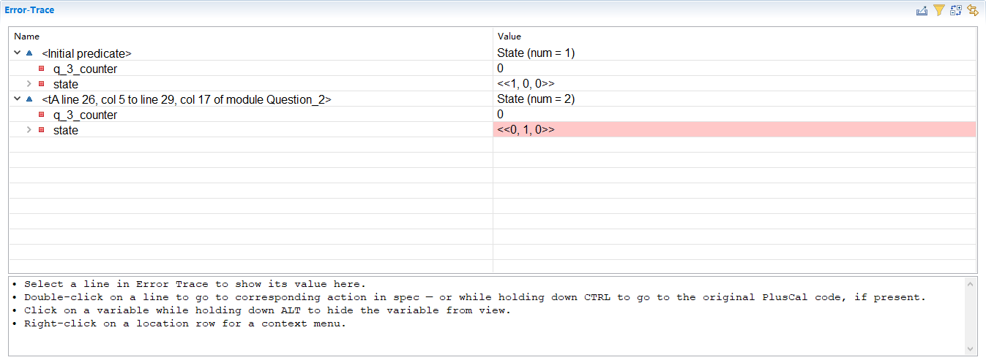
Use TLC checker to check the property
Result
Question 2 proposition is not hold
Notes:
For verification 1, we first describe the property that is shown here,
then set an upper-bound,
this is optional,
we will illustrate it in the next verification.
after push check button, the toolbox finds an error,
that is, the proposition may not hold, and it finds a trace.

Slide 28
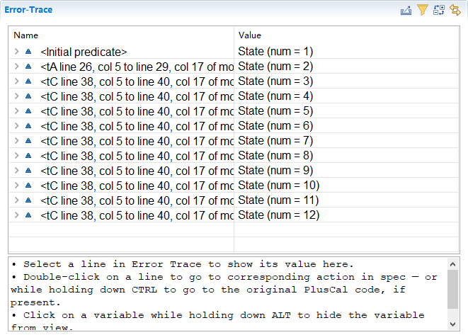
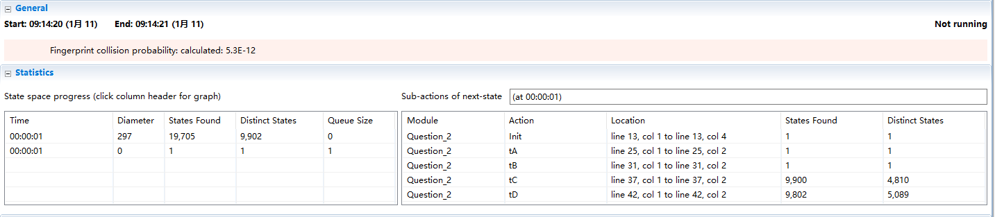
Use TLC checker to check the property
Result
First test q3_1, there is an error and TLA+ specified a trace to (0,1,10), that means A is true
Result
Then test q3_2, there is no error, that means B is error
Conclusion
Question 3 proposition is not hold
TLA+ & TLA+ toolbox
28 / 33

Slide 29
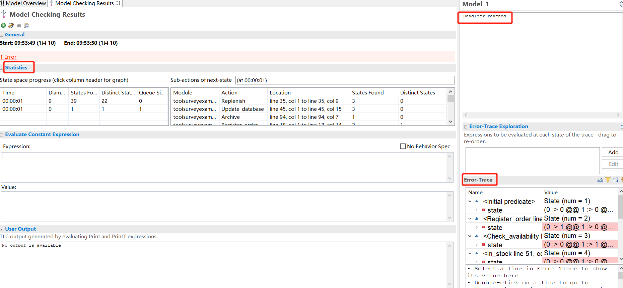
Structure
How to describe property
Outcome: statistics, trace, property

Slide 30
Demos
Notes:
In this section, we prepared two examples. Considering the limitation of time, they are based on Petri-net's assignment.

Slide 31
Demo 1
Considering a Petri-Net
Verification 2
Verification 3
Marking m = (0,1,10) can happen infinitely often
Notes:
The first one is this Petri-Net;
we will use TLA+ to test whether it satisfies “for any reachable marking, token in p2 is less than or equal to the token in p3.”
and test whether marking m=(0,1,10) can happen infinitely often

Slide 32
Model
Notes:
First, we model this system with TLA+
the Variable: state defines the places in the Petri net, and constant will be defined as the set of state index
Init defines the initial state, in which except place 0 is 1 other place is empty.
Each operation is defined as below
for example, tB means,
when at the current state, if place 1, has more than 1 token,
then transition tB can be fired,
and in next state, place 3 add one token,
place 1 minus 1 token,
the total possible transition is defined as Next;
the expression means,
in a state, if the condition is met, tA or tB or tC or tD can happen

Slide 33
Question 2
Describe the Property
Then set an upper-bound (optional here)
Result
Question 2 proposition is not hold
Notes:
For verification 1, we first describe the property that is shown here,
then set an upper-bound,
this is optional,
we will illustrate it in the next verification.
after push check button, the toolbox finds an error,
that is, the proposition may not hold, and it finds a trace.

Slide 34
Question 3
First divide into two steps A: initial state can arrive to the first (0,1,10) ? B: (0,1,10) can arrive at (0,1,10) again ? Initial Proposition = A\/ B
Attention:
Most times, TLA+ cannot test the property “Theoretically”
It tries to find whether a property is satisfied in a practical-size state space
Next describe the Property
Then set an upper-bound
Result
Then test q3_2, there is no error, that means B is error
Result
First test q3_1, there is an error and TLA+ specified a trace to (0,1,10), that means A is true
Conclusion
Question 3 proposition is not hold
Notes:
For verification 3,
we first divide it into two steps:
A: is from initial marking able to arrive at (0,1,10)?
B: is from (0,1,10) is able to come back (0,1,10)?
if both A and B is true, then the original proposition is true
Next, we modeled it by these two formulae,
the first means we can never arrive at (0,1,10)
the second means, the counter of times arriving at (0,1,10) can never become 2
But remember, we have mentioned that,
TLA+ is not able to test “theoretically.” , we need to smaller the state space to accelerate the search process
So for testing, we set the upper bound of states 2 and 3.
we tick on q3_1, the result is not hold
we tick on q3_2, the result holds.
So A hold while B not hold, so the original proposition is false、

Slide 35
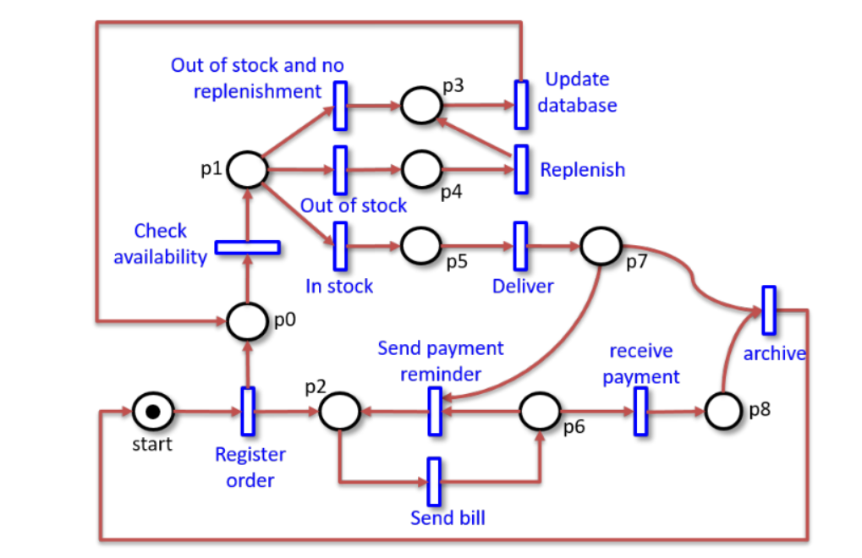
Demo 2
Considering another Petri-Net:
Verification 1: Whether there is a deadlock
Notes:
Here is the Demo 2, we check whether there is a deadlock

Slide 36
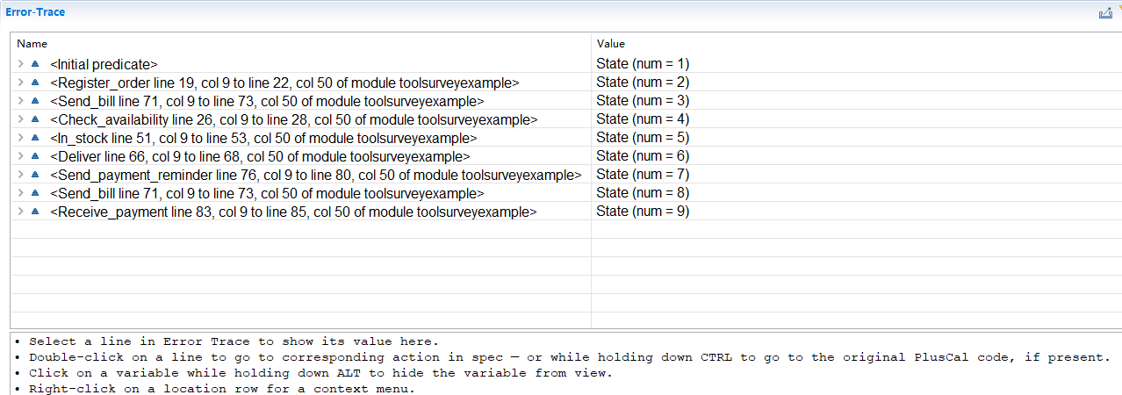
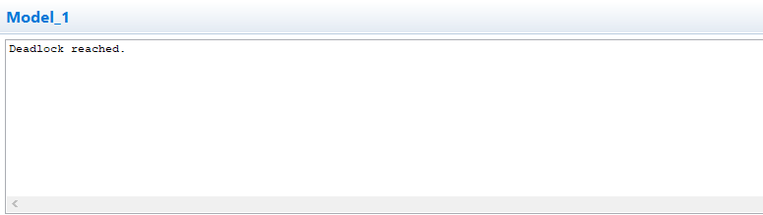
Solution
Build model
The program is too long to show here
Test
tick the “deadlock” in the model
Result
There is a deadlock error
Result
There is a deadlock error
Notes:
The program is too long to show here,
after checking, we can find an error,
which means there is a deadlock,
and TLA+ gives the trace.

Slide 37
Overview
Four subsections:
Introduction:
Formal specification language, Mathematical
Top-layer, Software, Hardware, Systems (especially DAs)
Basic Idea:
behavior → State Machine, Property → Searching (BFS);
Language & Usage:
How to build model
How to describe properties
How to use Toolbox
Demos:
Demo 1
Demo 2
Notes:
Here is an overview of today’s presentation.
First, we introduce the formal specifical language TLA+,
which is based on mathematical
and is a top-layer description of systems.
Second, we introduce the state machine, property check process, and the partial order
Third, we introduce the language grammar and usage of the toolbox
Finally, two demos are given here to help us understand it.

Slide 38
More Resources and Suggestion
official website https://lamport.azurewebsites.net/tla/tla.html
Overview of Basic Grammar https://learntla.com/introduction/
Video Resources https://www.youtube.com/channel/UCajiu4Cj_GHOX0if3Up-eRA
Google Group
https://groups.google.com/forum/?fromgroups#!forum/tlaplus
Suggestion
It is really important to practice coding examples by yourself !
Notes:
Here are several extra resources,
the official website,
a third-party introduction,
official video resources,
and a Google discussion group.
The only important suggestion is,
DO practice using it by yourselves.
It is quite hard to learn it just by going through books or videos.

Slide 39
Thanks

